Slide 1


PROJECT PROPOSAL
-FREE SPACE DETECTOR
TEAM WIRED WIZARDS

Slide 2


TABLE OF CONTENTS
Identification of the Problem
Technical Feasibility
Product Architecture
PRODUCT sketch of enclosure
Marketing Plan
Sales and Maintenance
Progress report
Task Allocation
Reference

Slide 3


Problem
Lack of real-time information about available seats and study areas in libraries and public spaces, leading to frustration and wasted time for visitors.
IDENTIFICATION OF THE PROBLEM
Solution
A device that provides real-time information about the number of available seats and spaces, helping visitors plan their visit and avoid frustration.

Slide 4
TECHNICAL FEASIBILITY
All required hardware components are available in the local market within our budget limit.
We will use a voltage regulator for safety and protection of the microcontroller and sensors.
The device will be durable, all modules are covered for protection from rain, dust, and sunshine.
Grid power will be used as the power source.
PCB and 3D printing will be done by hiring local professionals within our budget.
The enclosure material will be selected based on its ability to withstand different environmental conditions.

Slide 5

PRODUCT ARCHITECTURE
IR Sensor
voltage Regulator (5V)
Micro procssor
Power supply
LCD
IR Sensor

Slide 6
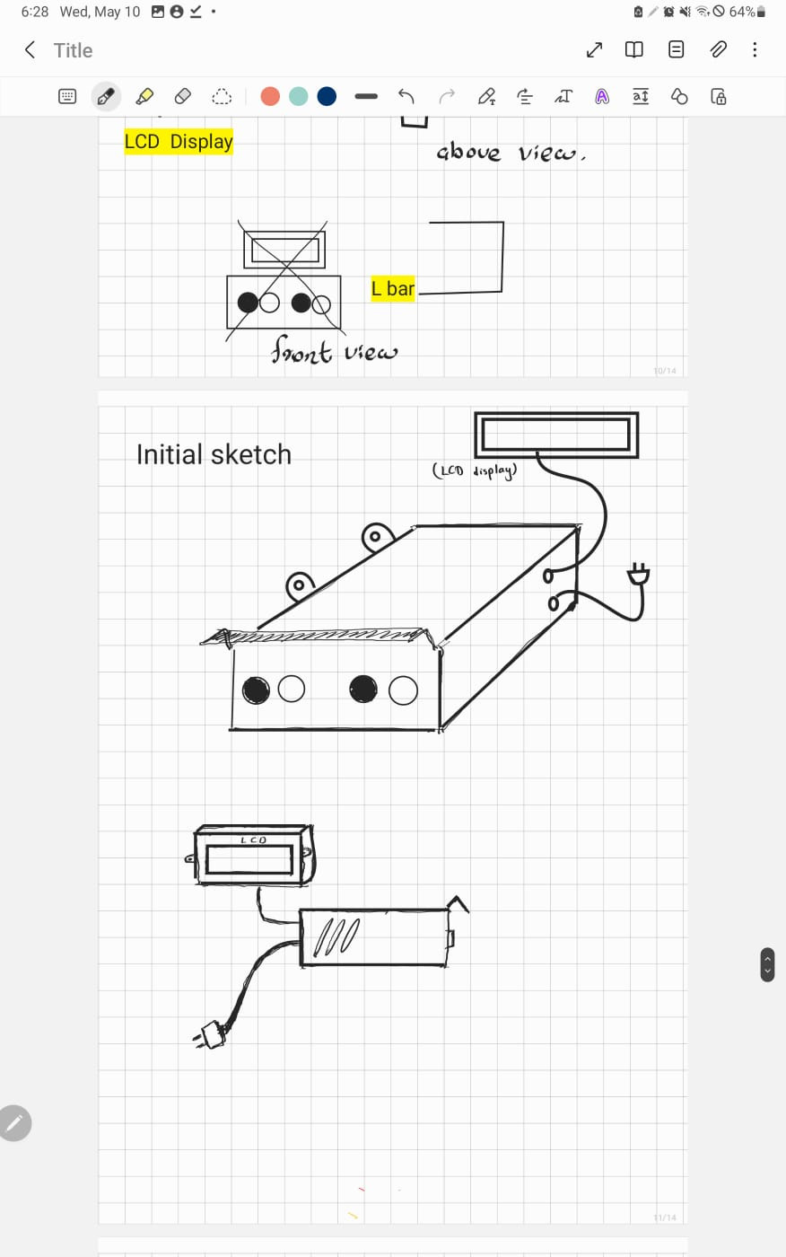
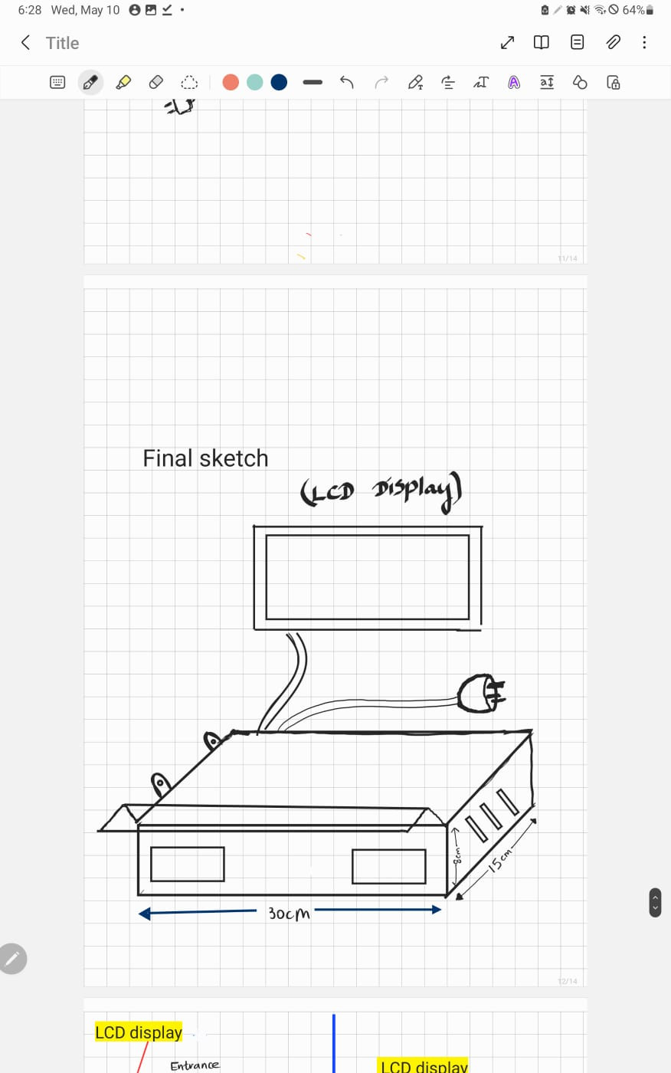
PRODUCT SKETCH OF ENCLOSURE

Slide 7
MARKETING PLAN
Targeting government offices, social control institutions, and public space management authorities through emails and visits.
Creating a website and using social media platforms (Facebook, Instagram, and YouTube) for wider market promotion.
Asking for customer reviews to boost sales.
Creating official accounts on YouTube, Facebook, and Instagram after reaching the market.
Sharing eye-catching flyers, posts, and videos through social media.
Creating introductory videos to compare the product with similar products in the market.

Slide 8
SALES
Selling the product in local tech stores.
Marketing the product on websites such as eBay, Amazon, Daraz, and Instagram.
MAINTENANCE
Provide printed manual for frequent maintenance instructions to customers.
Offer 1-year warranty period for each customer.
Customers can directly contact maintenance team for major issues.

Slide 9
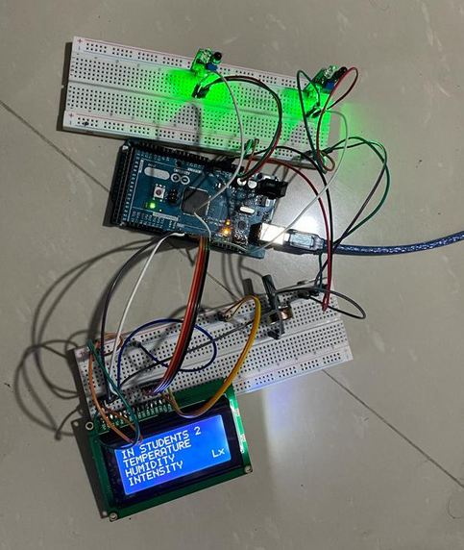
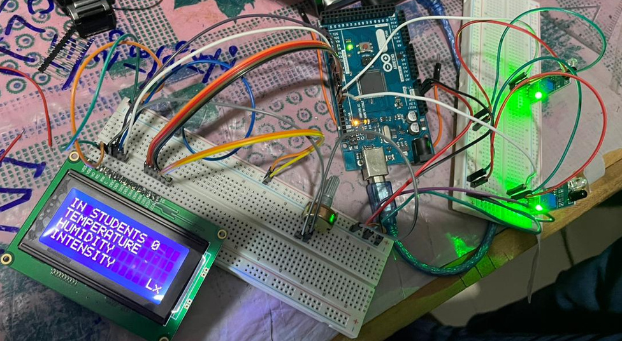
PROGRESS REPORT
Successfully tested the object detecting and counting circuit on a breadboard, using two IR sensors & two LEDs.
(when one IR sensor is covered by a moving object one LED would light while the other LED lights up when the other IR sensor is covered, while displaying the count on a LCD.)

Slide 10
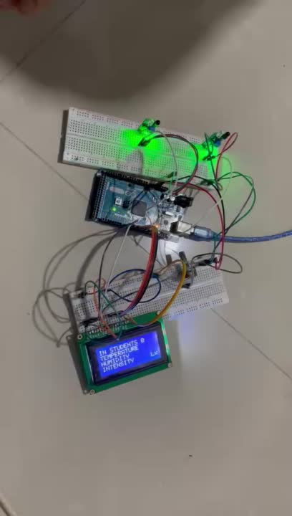
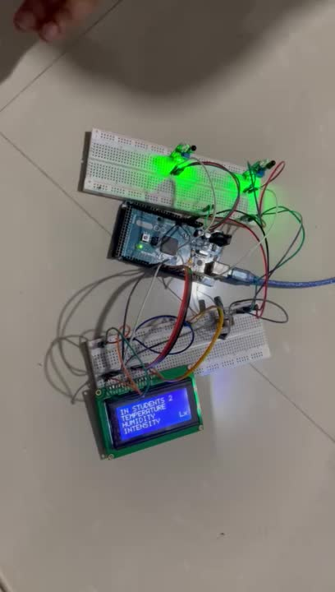
PROGRESS REPORT

Slide 11
PROGRESS REPORT
void instruction(){
lcd.setCursor(0,0);lcd.print("IN STUDENTS ");delay(100);
lcd.setCursor(0,1);lcd.print("TEMPERATURE ");delay(100);
lcd.setCursor(0,2);lcd.print("HUMIDITY ");delay(100);
lcd.setCursor(0,3);lcd.print("INTENSITY ");lcd.setCursor(14,3);lcd.print("Lx");delay(100);
}
void loop(){
lcd.setCursor(0,0);lcd.print("IN STUDENTS ");
lcd.setCursor(0,1);lcd.print("TEMPERATURE ");
lcd.setCursor(0,2);lcd.print("HUMIDITY ");
lcd.setCursor(0,3);lcd.print("INTENSITY ");lcd.setCursor(14,3);lcd.print("Lx");
counting();
}
// for counting system
void counting()
{
sensorState1 = digitalRead(sensorPin1);
sensorState2 = digitalRead(sensorPin2);
if(sensorState1 == LOW){
count++;
delay(300);
}
if(sensorState2 == LOW){
count--;
delay(300);
}
if(count<=0)
{
lcd.setCursor(12,0);lcd.print("0"); delay(100);
}
else if (count>0 && count<10){
lcd.setCursor(12,0);lcd.print(count);
}
else {
lcd.setCursor(12,0);lcd.print(count);
}
if (count<0){
alarm();
}
}
Ardiuno Code
#include<LiquidCrystal.h> //lcd
LiquidCrystal lcd(1,2,4,5,6,7);//lcd
// ir sensors
#define sensorPin1 8
#define sensorPin2 9
#define securityAlarm 10
//for ir sensors
int sensorState1 = 0;
int sensorState2 = 0;
int count=0;
void alarm(){
digitalWrite(securityAlarm,HIGH);
}
void setup() {
//lcd instruction registor opened
lcd.begin(16,4);
lcd.setCursor(0,0);lcd.print("IN STUDENTS ");delay(500);
lcd.setCursor(0,1);lcd.print("TEMPERATURE ");delay(500);
lcd.setCursor(0,2);lcd.print("HUMIDITY ");delay(500);
lcd.setCursor(0,3);lcd.print("INTENSITY ");lcd.setCursor(14,3);lcd.print("Lx");delay(500);
// lcd instruction registor closed
//Sensors are opened
pinMode (sensorPin1,INPUT_PULLUP);
pinMode (sensorPin2, INPUT_PULLUP);
pinMode (securityAlarm,OUTPUT);
}

Slide 12
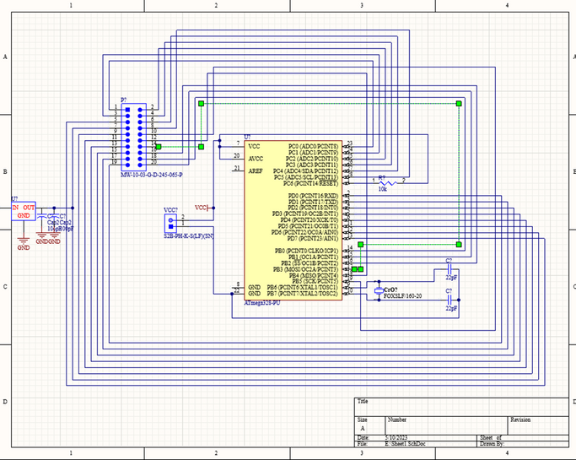
PROGRESS REPORT
PCB design
WE UTILIZED ALTIUM TO DESIGN OUR PRINTED CIRCUIT BOARD (PCB) AND ARE STILL IN THE PROCESS OF FINALIZING IT. WHILE WE DO NOT HAVE THE COMPLETED DESIGN AT THIS TIME, WE CAN PROVIDE A ROUGH SKETCH OF OUR PROGRESS.

Slide 13
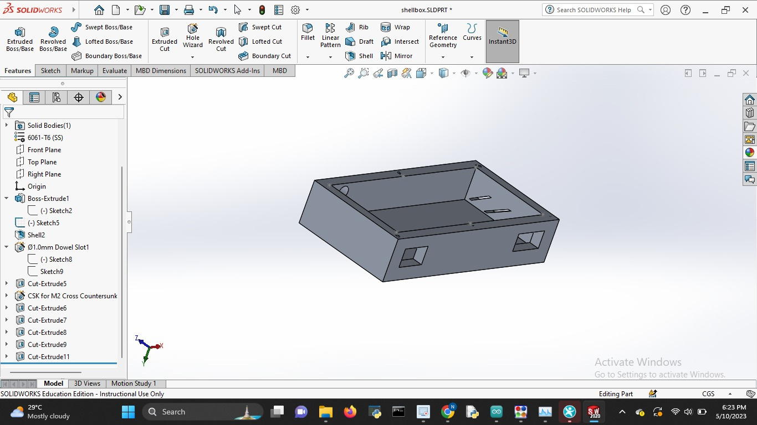
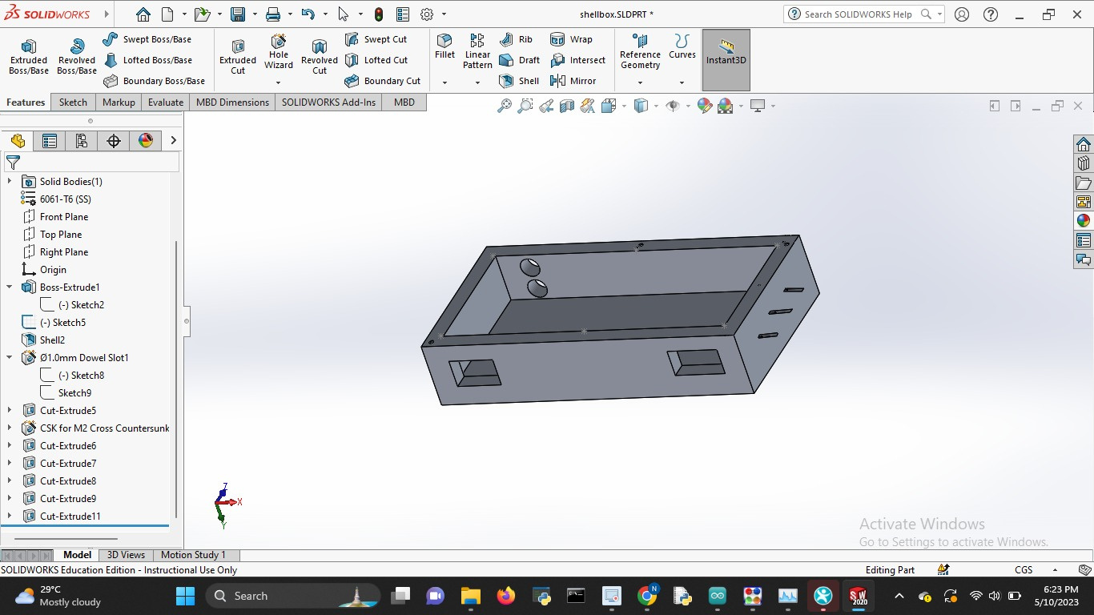
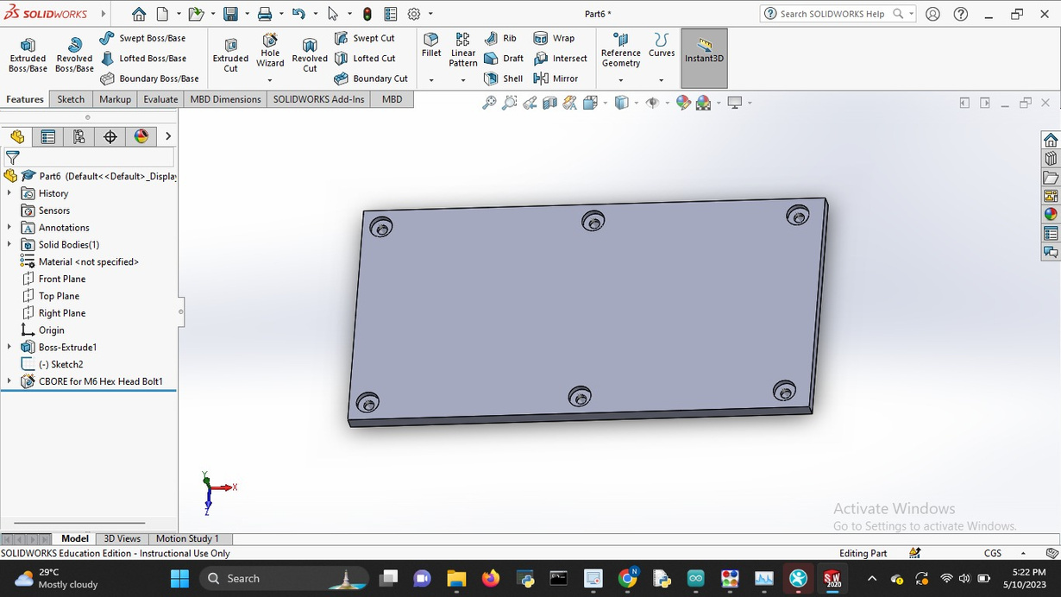
PROGRESS REPORT
Enclosure design sketch
Created a rough sketch and design of the enclosure for our device.
The design includes holes where the IR sensors would protrude and where the LCD and power supply would be connected.
It includes sufficient space for the PCB and other components.
(Lid)

Slide 14
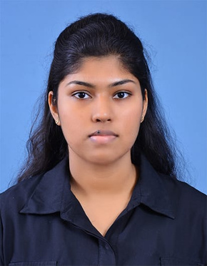



TASK ALLOCATION
Dasuni Herath
Rajitha Niroshan
Altium and PCB design, prototyping and testing
Altium and PCB design, prototyping and testing
Shaveen Herath
Nipuni Herath
Solidworks and enclosure design, Microcontroller programming
Solidworks and enclosure design,
Microcontroller programming

Slide 15

THANK YOU
REFERENCE
Tronic.lk - https://tronic.lk/
Automatic passenger counting systems for public transport - https://www.intelligenttransport.com/transport-articles/3116/automatic-passenger-counting-systems-for-public-transport/
Wikipedia - https://en.m.wikipedia.org/wiki/People_counter

